Slide 1


TumorXAI: Self-Supervised Deep Learning Framework for Explainable Brain MRI Tumor Classification (Paper ID - 849 ) [Abrar Hossain Zahin¹, Amit Kumar Saha, Tanvir Mridha, Saifur Rahman, Jannatul Ferdous Prome, Raima Husna, Israt Jahan, Ahmed Wasif Reza]
Presented By – Abrar Hossain Zahin
Department of CSE, East West University, Dhaka, Bangladesh 🇧🇩

Slide 2



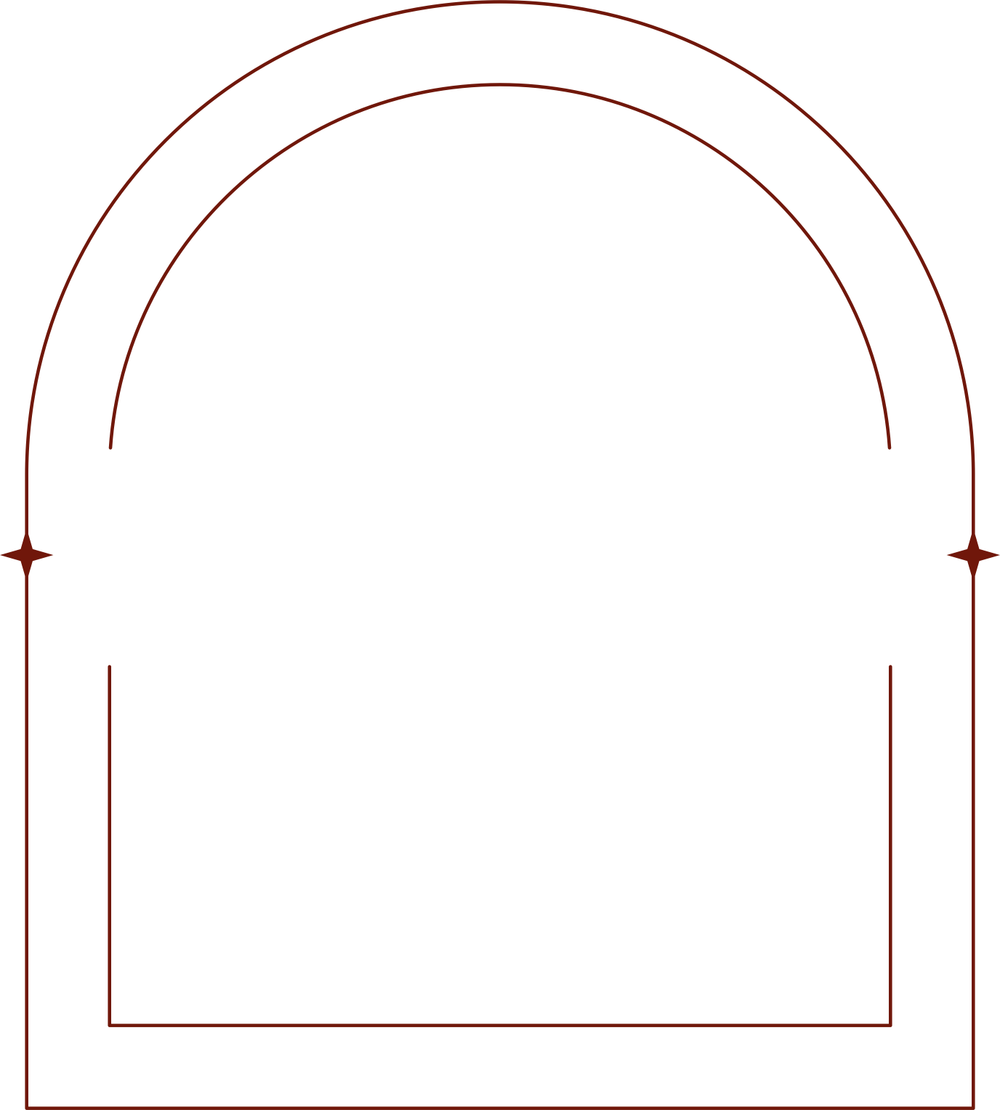
01
Introduction
Literature Review
02
03
Problem Description
04
Novelty
Proposed Method
Presentation
Outline
05
06
Dataset Details
Experimental Results
07
08
Conclusion
Bibliography
09
Page 02 of 14

Slide 3
Introduction
Brain tumors rank among the most lethal neurological diseases, with rising incidence and high morbidity/mortality.
Early detection via MRI is crucial but challenging due to tumor heterogeneity and overlapping structures.
Traditional CNNs excel in medical imaging but require large labeled datasets, which are costly and imbalanced for rare tumors.
Self-supervised learning (SSL) offers a solution by learning features from unlabeled data via pretext tasks.
This study evaluates SSL frameworks (SimCLR, BYOL, DINO, MoCo v3) on ResNet-50 for multi sub class tumor classification, achieving up to 99.64% accuracy.
XAI techniques (Grad-CAM, etc.) provide interpretability, essential for clinical trust.
Goal: Alleviate data scarcity, improve diagnostic accuracy, and assist radiologists.
Page 03 of 14

Slide 4
Literature Review
Study/Author(s) | Year | Model/Method | Dataset | Accuracy/Metrics | Notes/Novelty
Md. Mohaiminul Islam et al. | 2025 | Inception-ResNet V2 with Grad-CAM and GradientShap (XAI) | Merged (Figshare, SARTAJ, Br35H; 7,023 images: glioma, meningioma, no tumor, pituitary) | 99.53% acc; Precision/Recall/F1 ≥99.50%; IoU 99.01% | Dual XAI for anatomical localization; lightweight CNN variant (96.49% acc, 1.31M params) for edge devices; outperforms benchmarks.
Wei-Jun Zhang et al. | 2025 | Swin UNETR with contrastive SSL | BraTS2021 (1,251 cases) for pretraining; CHGH (33 cases, small tumors) | Dice 0.1882 (small tumors); Sensitivity 100%; Specificity 54.5% | SSL feasibility for small metastatic tumors; data augmentation (16x) addresses limited labels.
S. Priyadharshini et al. | 2025 | YOLOv11 (mentions self-supervised in review) | Figshare (2,100 images); BraTS2020 (3,170 slices) | 99.2% acc; F1 0.990; mAP@0.5 0.993 | Successive YOLO evaluation; integrates positional/semantic data via self-supervised elements for detection/segmentation.
Ramesh Babu Vure et al. | 2025 | GAN (WGAN-GP) + ResNet18 + DMFN | Private (3,000 images); BraTS2021 (1,251 scans) | 98.36% acc; Precision/Recall/F1 >97%; AUC 0.997 | Augmentation and fusion for multi-class; no explicit SSL but tackles data limits.
Meryem Altin Karagoz et al. | 2024 | ResViT (generative SSL: CNN-Transformer hybrid) | BraTS2023; Figshare (3,064 images); Kaggle (7,023 images) | 98.53% acc (Figshare); PSNR/SSIM for synthesis ~25/0.88 | Generative pretext for augmentation; outperforms ImageNet-pretrained models; domain adaptation.
Eid Albalawi et al. | 2024 | Custom 25-layer CNN | figshare/SARTAJ/Br35H (7,023 images) | 99% acc; F1 per class 0.97-1.00 | Multi-layer customization with augmentation; high efficiency.
Page 04 of 14

Slide 5







Problem Formulation/ Problem Description
Core Challenge
Data Scarcity
Interpretability Gap
Formulation
Objectives
Real-World Impact
Classifying 17 brain tumor types from MRIs amid heterogeneity, overlapping tumors, and rare subtypes leading to class imbalance.
Supervised Deep Learning needs large annotated datasets, but medical labeling is expensive and time-consuming.
Black-box models hinder clinical adoption; need visual insights into decisions.
Given unlabeled MRI dataset, learn representations via SSL pretext tasks to maximize downstream classification accuracy for labels y ∈ {1..17}.
Improve feature learning without labels; outperform supervised baselines when labels are limited; enhance explainability.
Addresses rising tumor incidence; supports early diagnosis for better survival rates.
Page 05 of 14

Slide 6

Novelty
Aspect | Prior Works | This Study
SSL Frameworks | Limited | Comparative (4 methods)
Classes | Fewer (around 4 classes) | 17 tumor types
Interpretability | Minimal | Full XAI integration
Accuracy in Low-Label | Variable (93-99%) | Up to 99.64%
Page 06 of 14

Slide 7

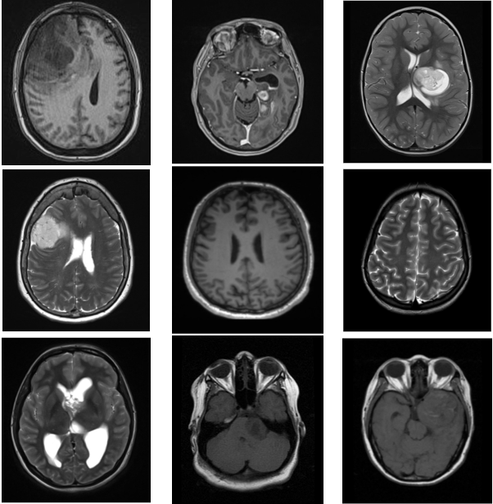



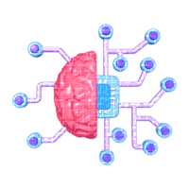


Proposed Method
Dataset Collection
Preprocessing
Model Pretraining
Linear Probe and
Model Tuning
Model Evaluation
XAI
Rotation, Width-shift, Height-shift, Zoom, Horizontal-Flip, Brightness, Normalize
Confusion Matrix
Generalization
Accuracy, Precision, Recall, F1-Score, Loss Curve
Grad-CAM
Grad-CAM++
Eigen-CAM
Brain Tumor MRI Images 17 Classes Dataset
ResNet50 + SSL(SimCLR, BYOL, DINO, Moco v3)
Page 07 of 14

Slide 8
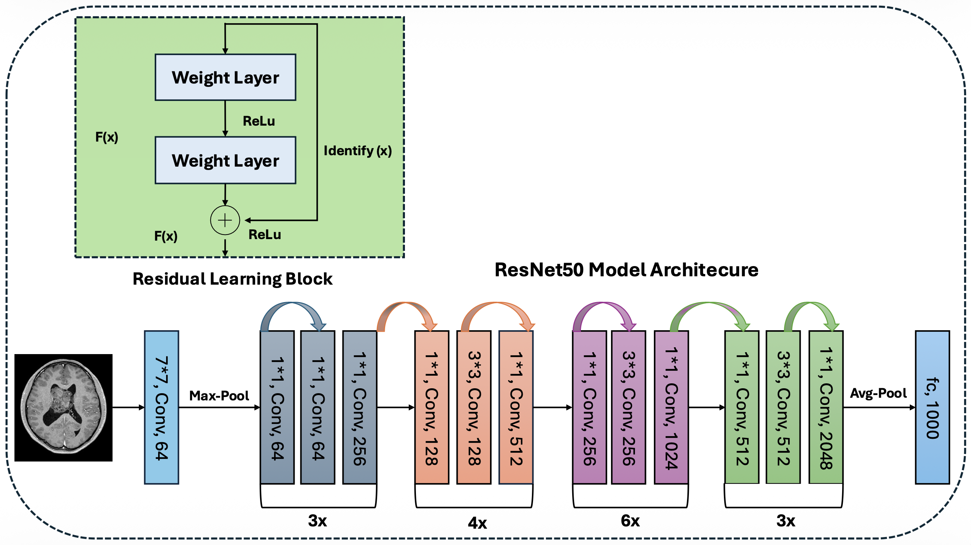
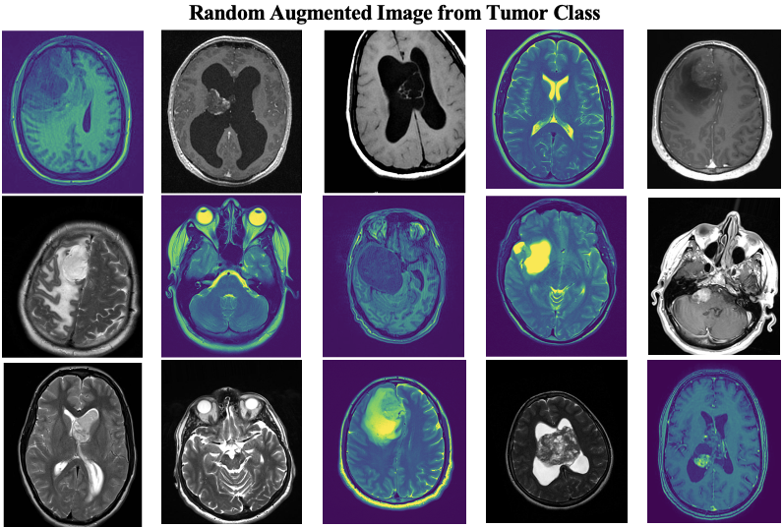
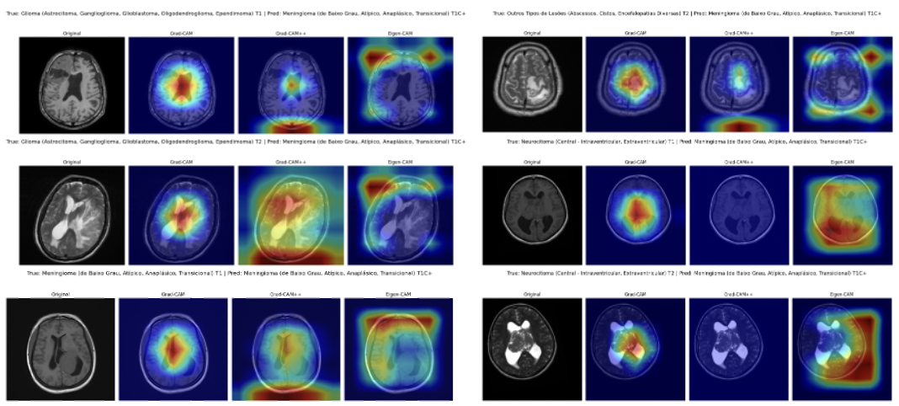
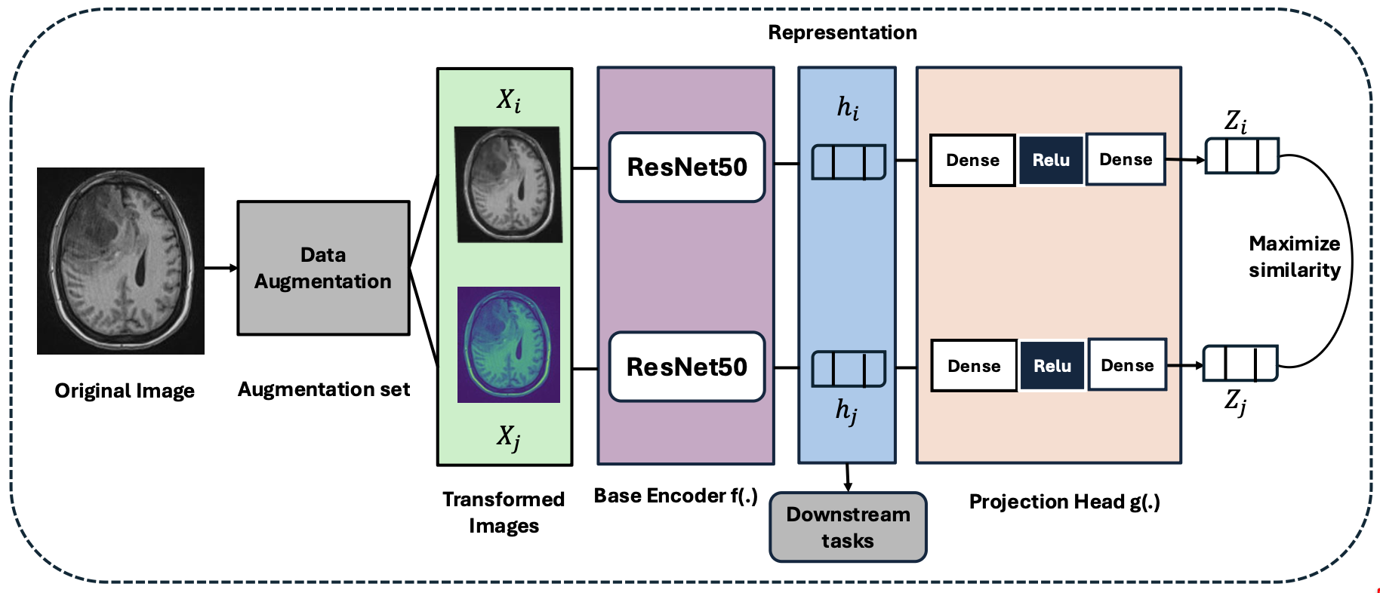
Proposed Method
SSL Frameworks:
SimCLR: Contrastive learning with projection head; maximizes agreement between augmented views.
BYOL: Asymmetric encoder-teacher setup; avoids negative pairs.
DINO: Knowledge distillation with centering; focuses on global-local views.
MoCo v3: Momentum contrast with queue; stable for large batches.
Backbone: ResNet-50 (50 layers, residual blocks for deep feature extraction).
Augmentations: Rotation (±20°), shifts (10%), zoom (±10%), flip, brightness [0.8-1.2], Gaussian blur.
Evaluation: Cross-entropy loss; early stopping (patience=10); metrics: accuracy, precision, recall, F1.
XAI: Heatmaps to explain model focus on tumor regions.
Page 08 of 14

Slide 9
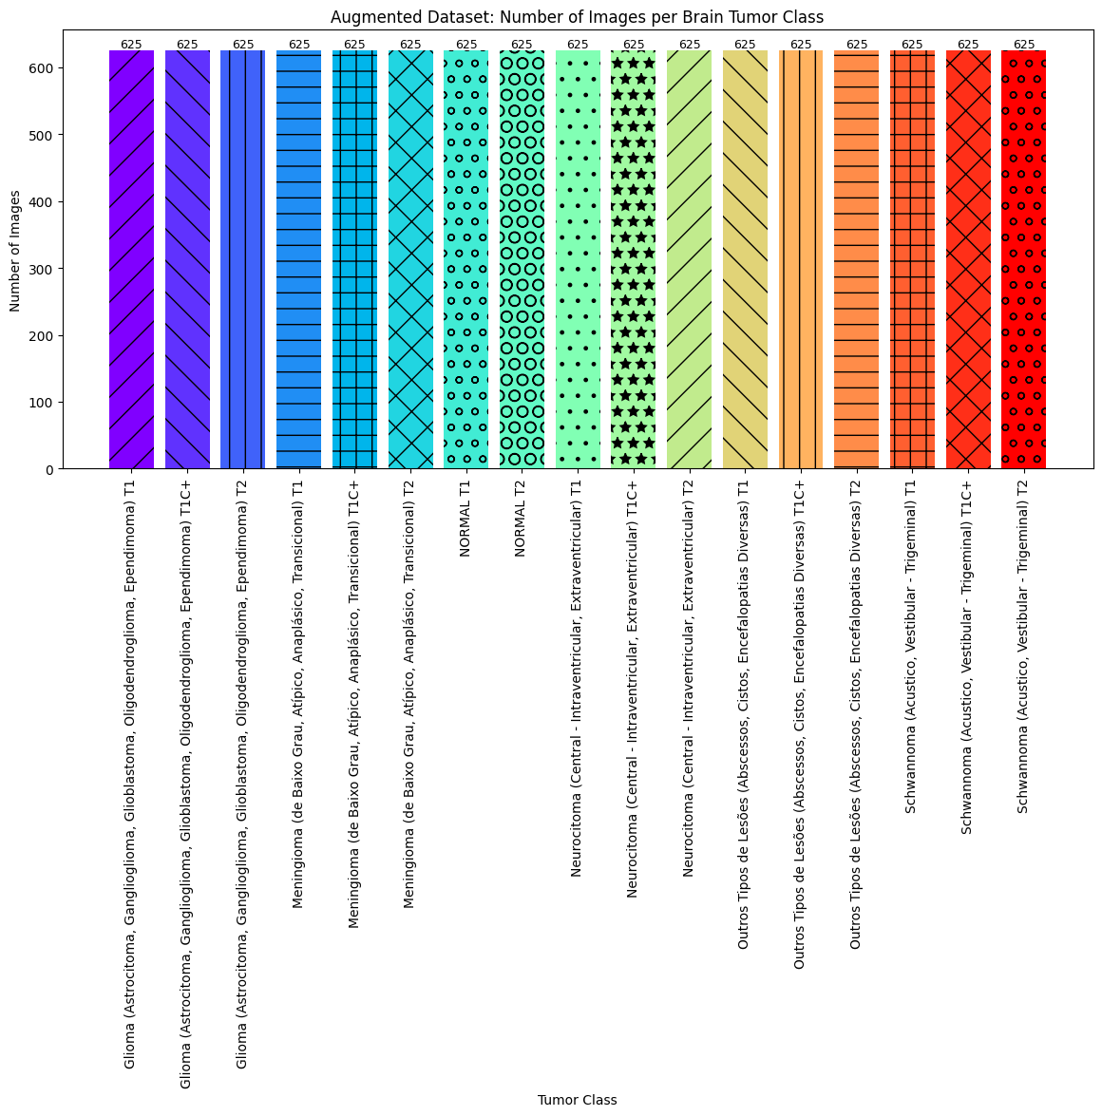
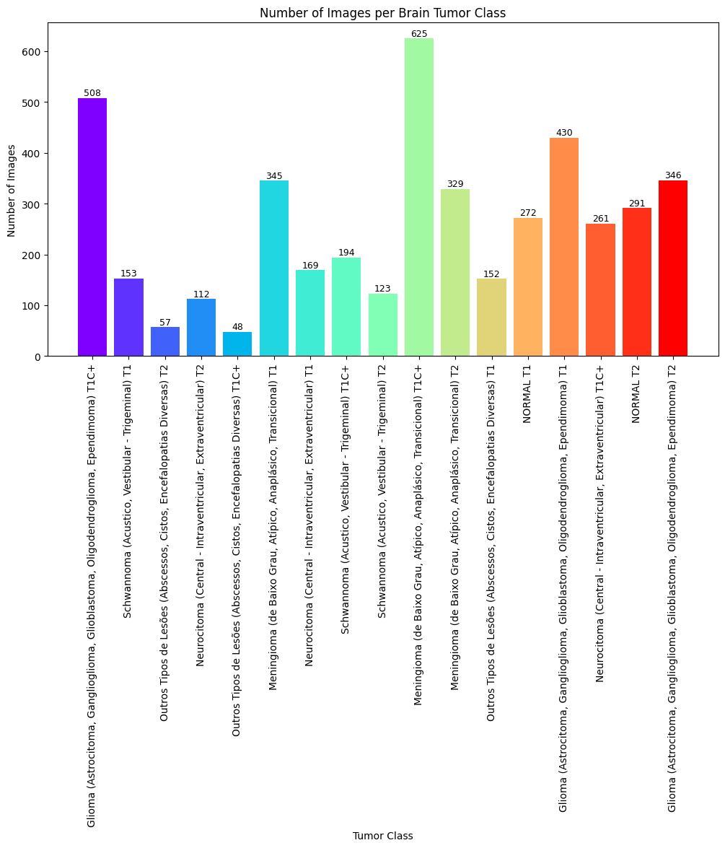
Dataset Details/ Benchmark/ Simulation Platform
Tumor Class | Amount (T1C+, T1, T2) | Total
Glioma | 508 + 430 + 346 | 1,284
Schwannoma | 153 + 194 + 123 | 470
Meningioma | 345 + 625 + 329 | 1,299
Neurocitoma | 169 + 261 + 112 | 542
Other Lesions | 152 + 48 + 57 | 257
Normal | 272 + 291 | 563
Grand Total |  | 4,448
Page 09 of 14

Slide 10
Experimental Results
Performance Metrics (Fine-Tuning & Linear Eval)
Model | Fine-Tune Acc (%) | Precision | Recall | F1 | Linear Eval Acc (%) | Precision | Recall | F1
SimCLR | 99.64 | 0.9964 | 0.9964 | 0.9964 | 91.04 | 0.9149 | 0.9104 | 0.9099
BYOL | 97.66 | 0.9781 | 0.9766 | 0.9766 | 85.94 | 0.8996 | 0.8594 | 0.8621
DINO | 98.68 | 0.9870 | 0.9868 | 0.9868 | 45.24 | 0.5571 | 0.4522 | 0.4072
MoCo v3 | 99.48 | 0.9949 | 0.9948 | 0.9948 | 94.84 | 0.9520 | 0.9484 | 0.9483
Testing & Validation Metrics
Model | Test Acc (%) | Precision | Recall | F1 | Valid Acc (%) | Precision | Recall | F1
SimCLR | 97.27 | 0.9738 | 0.9726 | 0.9727 | 97.65 | 0.9769 | 0.9765 | 0.9762
BYOL | 96.14 | 0.9646 | 0.9614 | 0.9611 | 93.50 | 0.9395 | 0.9352 | 0.9340
DINO | 95.58 | 0.9576 | 0.9558 | 0.9561 | 94.26 | 0.9465 | 0.9425 | 0.9430
MoCo v3 | 94.92 | 0.9535 | 0.9493 | 0.9494 | 95.86 | 0.9601 | 0.9585 | 0.9588
Page 10 of 14

Slide 11
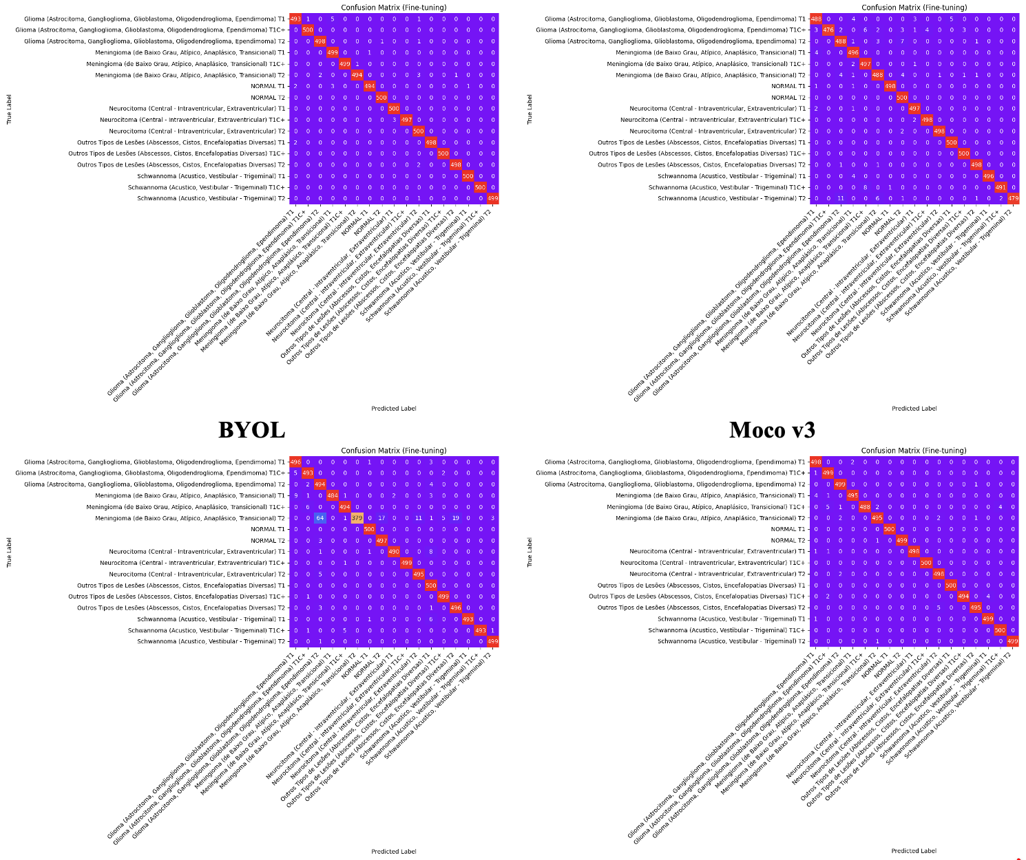
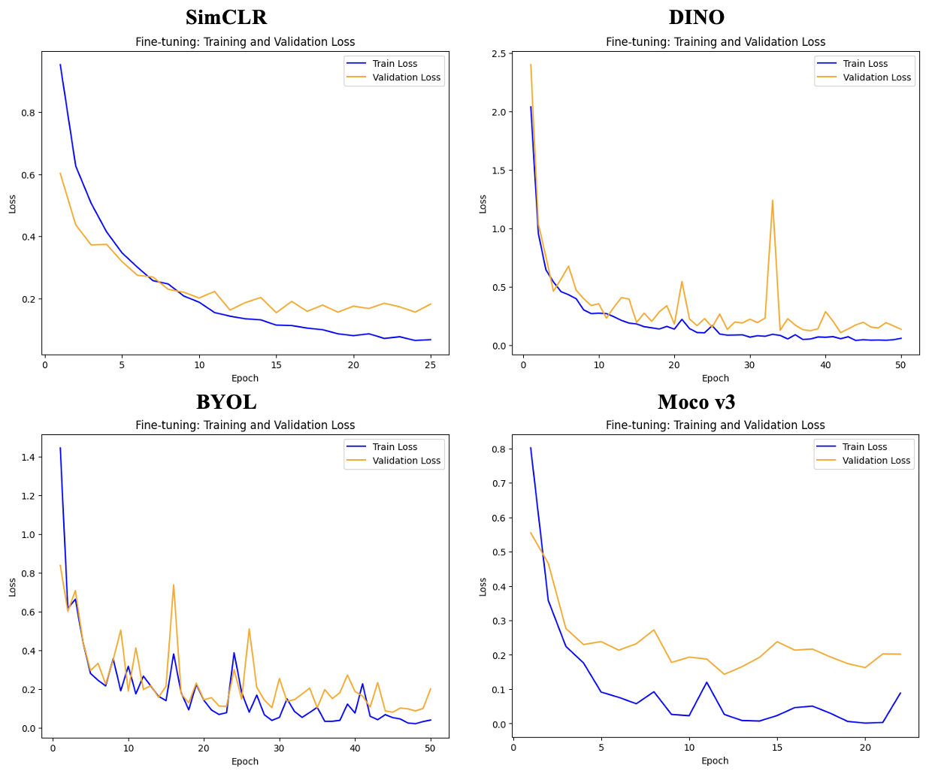
Experimental Results
Page 11 of 14

Slide 12



Conclusion
02
04
Key achievements
Practical Implications
05
01
03
High accuracy (99.64%), robust feature separation, and interpretable decisions via XAI.
Scalable tool for radiologists; enhances early diagnosis and trust in AI.
Future Directions
SSL Algorithms
Limitations
Integrate multi-sequence MRIs, explore advanced SSL variants, and validate on diverse datasets
SimCLR emerges as the top performer, demonstrating SSL's potential to outperform supervised methods in label-scarce environments.
Performance drops in validation/testing due to overfitting; single-sequence focus may miss multi-modal insights.
Page 12 of 14

Slide 13
Bibliography
Task/Study | Best Model | Dataset | Accuracy (%) | Notes
Self-Supervised MRI | BYOL (ResNet-50) | MRI dataset | 97.66 | Strong representation learning
MRI Sequence Classification | MLvirtual + Multicenter | Hospital | 93.43 | Rule-based virtual labeling
Brain Tumor Segmentation | Swin UNETR | BraTS+CHGH | 96.27 | Outperforms U-Net
Image Classification | DINOV2 ViT-S14 | Test set | 99.84 | Perfect AUC
This Study (2025) | SimCLR-based SSL | Multi MRI dataset | 99.64 | Best generalization for brain MRI
Page 13 of 14

Slide 14

Thank You

